Slide 1
Cancer-Age Classification

Slide 2
Summary
No overlap between the list of selected 30 features for Age Detection on No-Cancer group and the list of the selected features for Cancer Detection on Young group.
8 of 30 CGs (selected form Age Detection on Young Group) are capable in Cancer Detection on Young Group by simply setting a threshold for each of them.
Build a new model with selected 150 features to classify Young Cancer/Young No-Cancer/Old Cancer/Old No-Cancer and achieve a test accuracy of 89.55% (best prior baseline model is 62.87%).

Slide 3
30 Age-Detection features (No-Cancer Group) For Cancer-Detection (Young Group)

Slide 4
No-Cancer Group Age Detection: 30 features

Slide 5
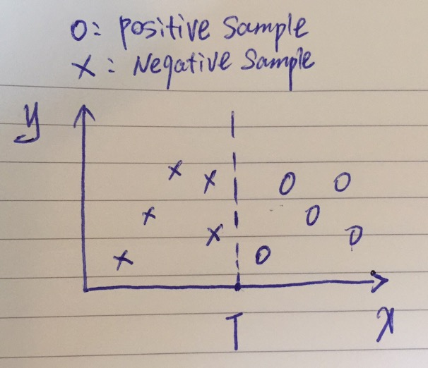
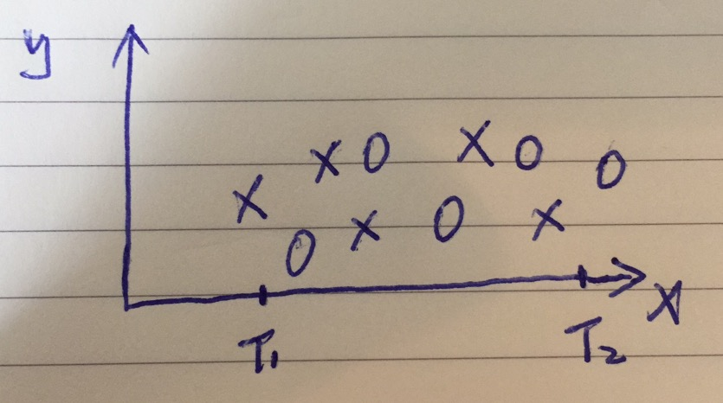
One-Dimensional Binary Classifier
When x >= T, label the input sample as Positive
When x < T, label the input sample as Negative
The best classifier = the optimal threshold T
maximizes performance
= True Positive Rate + True Negative Rate
True Positive Rate (TPR) = True Positives / Positives
True Negative Rate (TNR) = True Negatives / Negatives
2.0 >= Performance >= 1.0

Slide 6
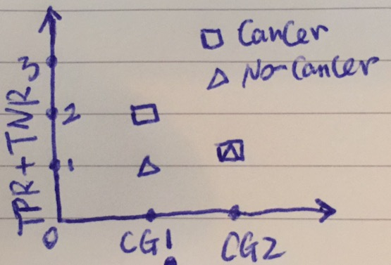
Identify Capable CGs
Question: for a given CG, do people with Cancer
usually have a high value? ([0, 1])
Answer: No.
Solution: consider Cancer and No-Cancer as Positive
alternative and compare the optimal
performances (TPR+TNR) of the two cases.
Capability := |perf1 – perf2|
CG1
CG2

Slide 7
Best TPR+TNR achieved by each of 30 features

Slide 8
Performance Difference -- Cancer-samples-higher-value vs No-Cancer-samples-higher-value

Slide 9
8 Capable CGs in Young-Group Cancer Detection
 |  |  | Cancer |  |  |  |  |  | No-Cancer
 | Feature Importance | threshold | tpr+tnr | tpr | fnr | tnr | fpr | threshold | tpr+tnr | tpr | fnr | tnr | fpr
cg05415871 | 0.31402636 | 0.9088 | 1.3747 | 0.8095 | 0.1905 | 0.5652 | 0.4348 | 0.7752 | 1.0559 | 0.913 | 0.087 | 0.1429 | 0.8571
cg07804728 | 0.27804953 | 0.8902 | 1.5445 | 0.7619 | 0.2381 | 0.7826 | 0.2174 | 0.7636 | 1 | 1 | 0 | 0 | 1
cg13493426 | 0.22419369 | 0.6796 | 1.0435 | 1 | 0 | 0.0435 | 0.9565 | 0.8103 | 1.2981 | 0.8696 | 0.1304 | 0.4286 | 0.5714
cg02886806 | 0.21960932 | 0.8442 | 1.383 | 0.9048 | 0.0952 | 0.4783 | 0.5217 | 0.7056 | 1 | 1 | 0 | 0 | 1
cg04836492 | 0.16413854 | 0.8865 | 1.3458 | 0.4762 | 0.5238 | 0.8696 | 0.1304 | 0.2825 | 1 | 1 | 0 | 0 | 1
cg05599106 | 0.10527176 | 0.1338 | 1.0559 | 0.1429 | 0.8571 | 0.913 | 0.087 | 0.0919 | 1.3458 | 0.8696 | 0.1304 | 0.4762 | 0.5238
cg22407458 | 0.06130385 | 0.3369 | 1.5921 | 0.8095 | 0.1905 | 0.7826 | 0.2174 | 0.1996 | 1.0994 | 0.9565 | 0.0435 | 0.1429 | 0.8571
cg26333652 | 0.05850984 | 0.6224 | 1.4845 | 0.5714 | 0.4286 | 0.913 | 0.087 | 0.3991 | 1.2381 | 1 | 0 | 0.2381 | 0.7619

Slide 10
4-labels Classifier for differentiate Young Cancer Young No-Cancer Old Cancer Old No-Cancer

Slide 11
Dataset Statistics
Base Profiles | Accuracy
Random Guess | 0.2500
Always Young No-Cancer | 0.0689
Always Young Cancer | 0.0629
Always Old No-Cancer | 0.6287
Always Old Cancer | 0.2395
WholeSet | Young | Old | All
Total | 44 | 290 | 334
Cancer | 21 | 80 | 101
No-Cancer | 23 | 210 | 233

Slide 12
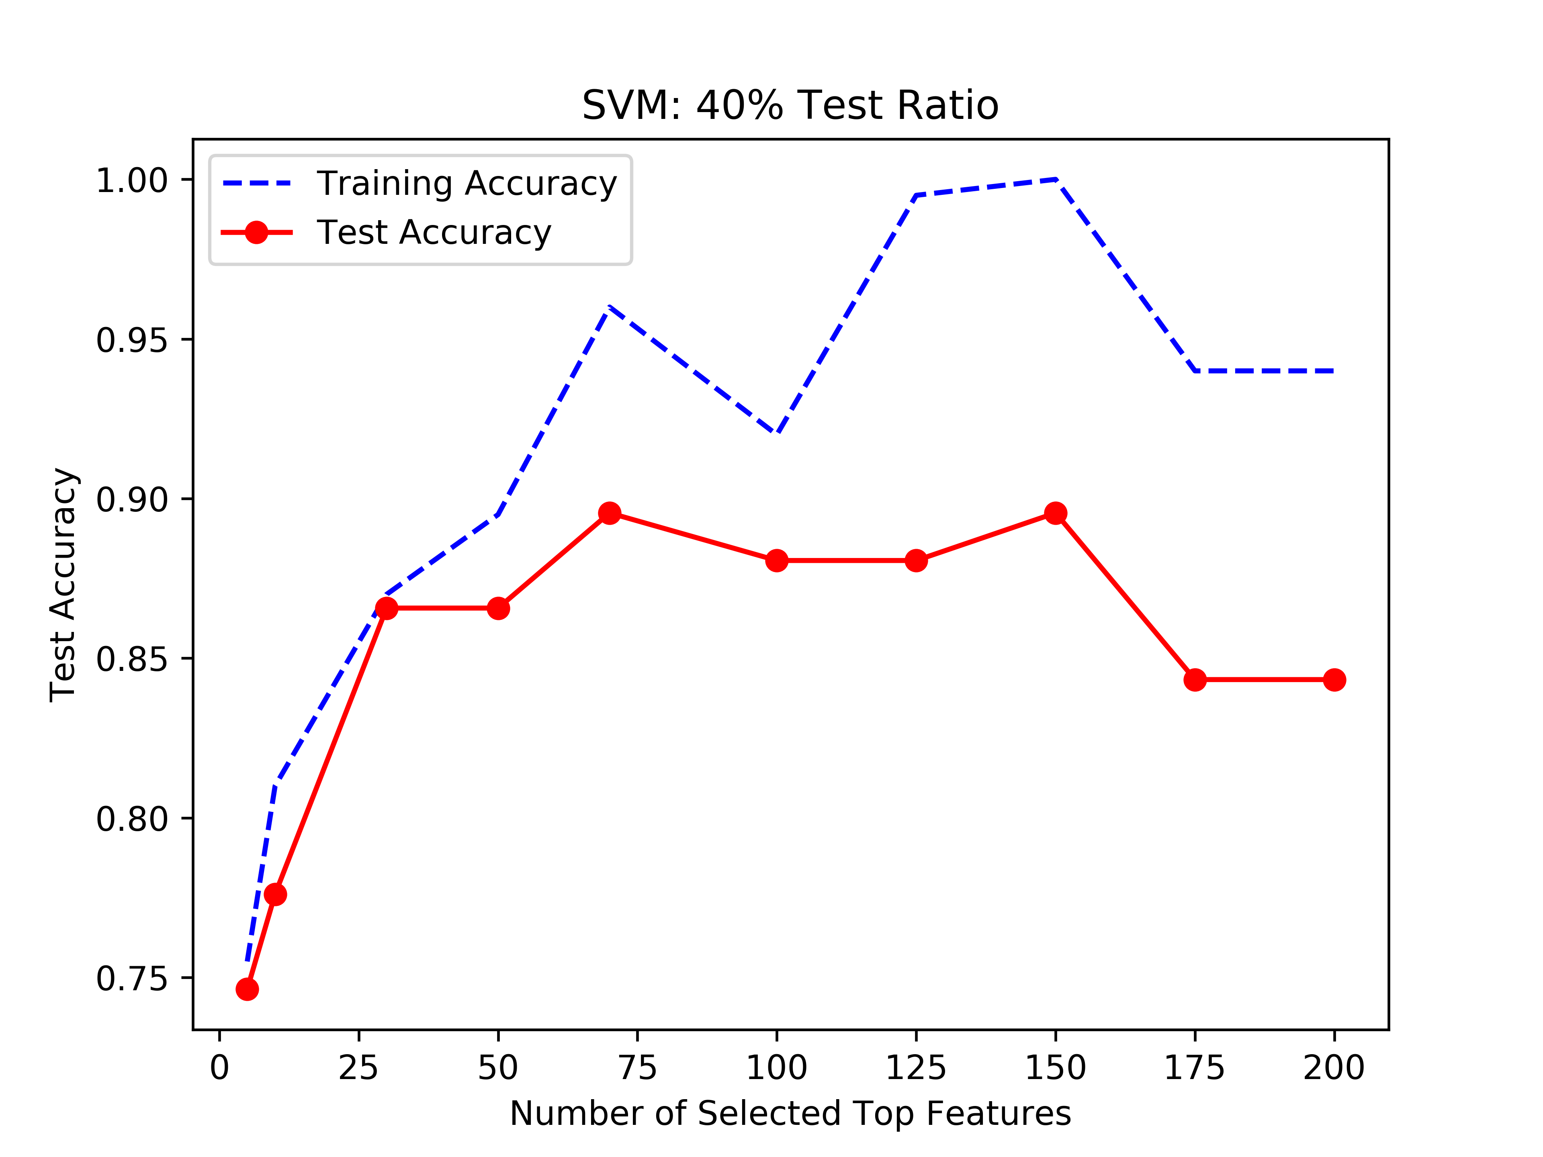
150 features: Highest Test Accuracy (89.55%)
Always Old No-Cancer | 0.6287

Slide 13
Clustering Analysis: 150 features

Slide 14
Mean of feature values in each group: 150 features

Slide 15
Mean of feature values in each group -- 66 features good at differentiating Cancer/No-Cancer

Slide 16
Mean of feature values in each group -- 19 features good at differentiating Young/Old

Slide 17
Best TPR+TNR achieved by each CGs

Slide 18
Best TPR+TNR achieved by each of 150 CGs

Slide 19
Best TPR+TNR achieved by each of 66 CGs -- Cancer/No-Cancer

Slide 20
Best TPR+TNR achieved by each of 150 CGs -- Young/Old

